Slide 1
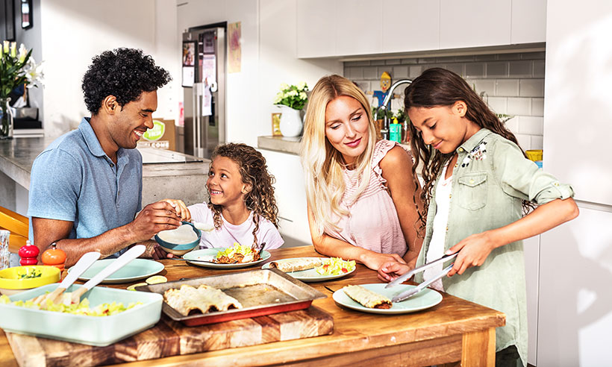
Cooking verbs

Slide 2
to fry

Slide 3
to boil

Slide 4
to cut

Slide 5
to bake

Slide 6
to grate

Slide 7
to peel

Slide 8
to slice

Slide 9
to mix

Slide 10
to add

Slide 11
to serve

